Slide 1

CSS

Slide 2
CSS - Cascading Style Sheet

Slide 3
Introduction to CSS
CSS stands for cascading style sheet. The saga of CSS starts in 1994. CSS is also not a programming language. CSS allows you to apply different styles to your web page so that your page looks presentable and attractive. It describes how HTML elements are to be displayed on the screen. CSS adds color to our web page. CSS really helps to format your web page and saves you lots of time. HTML help to write content like headings, paragraphs, buttons, images, forms, and tables. While CSS determines things like color, font size, positions of elements, align-items, and many more.

Slide 4
Why Use CSS?
Now this question comes to everyone’s mind? can we build a website without CSS? The answer is yes you can. But your website looks ugly it’s not presentable. No user will want to visit your website. CSS adds color to your website. It helps to format your web page. HTML is the basic structure of your web page. CSS helps to format your web page. Your website looks attractive and presentable. HTML was created to describe the content of a web page.

Slide 5
How Use CSS?
You can add CSS to Html page in three different ways:
Inline CSS
Internal CSS
External CSS

Slide 6
Inline CSS
You can add inline CSS by using the ‘style’ attribute of the HTML element. This way is mostly used when we need to apply the style to one unique element.
EXAMPLE:
<!DOCTYPE html>
<html>
<head>
<title>INLINE STYLE</title>
</head>
<body>
<h1 style="color: red; background: black;">This is Example of inline style</h1>
<p style="background: black; color: blue;">This is Example of inline style</p>
</body>
</html>

Slide 7
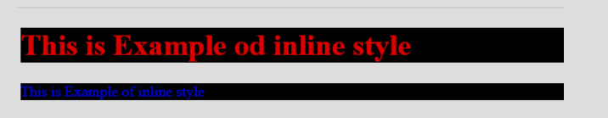
Inline CSS
Output:

Slide 8
Internal CSS
The internal CSS is not the most preferred way but this way is used when we need to apply style for a single page. Internal CSS added in <head> section within <style> tag.

Slide 9
Internal CSS
<!DOCTYPE html>
<html>
<head>
<title>Internal Style</title>
<style >
h1{
color: red;
background: blue;
}
p{
color: black;
background: blue;
}
</style>
</head>
<body>
<h1>This the Example of Internal Style</h1>
<p>This the Example of Internal Style</p>
</body>
</html>

Slide 10
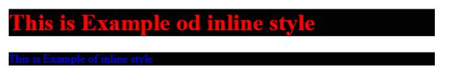
Internal CSS
Output:
The output will be the same but method is different:
Output:

Slide 11
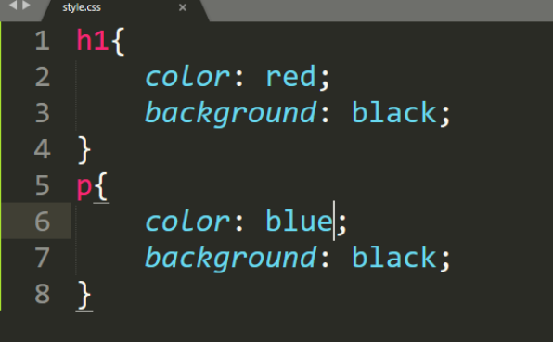
External CSS
Output:
External CSS is most preferred way to add CSS to Website. First of all create a separate CSS file with “.css” extension.
Example:

Slide 12
External CSS
Output:
Add this file to <head> section of Html page by using the <link> tag.
Example:
<!DOCTYPE html>
<html>
<head>
<title>Internal Style</title>
<link rel="stylesheet" type="text/css" href="style.css">
</head>
<body>
<h1>This the Example of Internal Style</h1>
<p>This the Example of Internal Style</p>
</body>
</html>

Slide 13
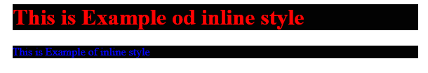
External CSS
Output:
Output:
The result of external CSS is also same but the method of writing CSS code is different.

Slide 14

CSS Box Model
Output:
In CSS, the term "box model" is used when talking about design and layout.
The CSS box model is essentially a box that wraps around every HTML element. It consists of: margins, borders, padding, and the actual content. The image below illustrates the box model:

Slide 15
Priority of Styles in CSS
Output:
Inline vs Internal css
Inline
Inline V
Internal vs External css
Internal
Inline
Inline vs External css

Slide 16
Fonts
font-family
font-style
color
font-weight
text-decoration
font-size
letter-spacing

Slide 17
Font Family
In CSS, we use the font-family property to specify the font of a text.
The font-family property specifies the font for an element.
The font-family property can hold several font names as a "fallback" system. If the browser does not support the first font, it tries the next font.
There are two types of font family names:
family-name - The name of a font-family, like "times", "courier", "arial", etc.
generic-family - The name of a generic-family, like "serif", "sans-serif", "cursive", "fantasy", "monospace".
Start with the font you want, and always end with a generic family, to let the browser pick a similar font in the generic family, if no other fonts are available.

Slide 18
Font Family
<!DOCTYPE html>
<html>
<head>
<style>
.p1 {
font-family: "Times New Roman", Times, serif;
}
.p2 {
font-family: Arial, Helvetica, sans-serif;
}
.p3 {
font-family: "Lucida Console", "Courier New", monospace;
}

Slide 19
Font Family
</style>
</head>
<body>
<h1>CSS font-family</h1>
<p class="p1">This is a paragraph, shown in the Times New Roman font.</p>
<p class="p2">This is a paragraph, shown in the Arial font.</p>
<p class="p3">This is a paragraph, shown in the Lucida Console font.</p>
</body>
</html>

Slide 20
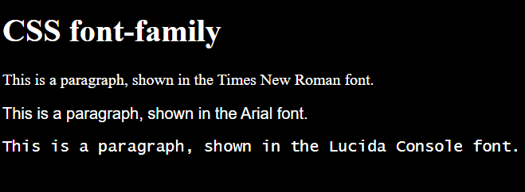
Font Family
Output:

Slide 21
Font Style
The font-style property is mostly used to specify italic text.
This property has three values:
normal - The text is shown normally
italic - The text is shown in italics
oblique - The text is "leaning" (oblique is very similar to italic, but less supported)

Slide 22
Font Style
<!DOCTYPE html>
<html>
<head>
<style>
body{
background:black;
color:white;
font-size:20px;
}
p.normal {
font-style: normal;
}

Slide 23
Font Style
p.italic {
font-style: italic;
}
p.oblique {
font-style: oblique;
}
</style>
</head>
<body>
<h1>The font-style property</h1>
<p class="normal">This is a paragraph in normal style.</p>

Slide 24
Font Style
<p class="italic">This is a paragraph in italic style.</p>
<p class="oblique">This is a paragraph in oblique style.</p>
</body>
</html>

Slide 25
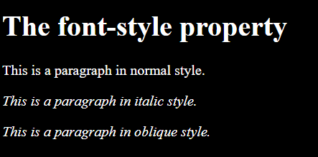
Font Style
Output:

Slide 26
color
The color property is used to set the color of the text. The color is specified by:
a color name - like "red"
a HEX value - like "#ff0000"
an RGB value - like "rgb(255,0,0)"
The default text color for a page is defined in the body selector.

Slide 27
color
<!DOCTYPE html>
<html>
<head>
<style>
body {
color: blue;
background-color:black;
}
h1 {
color: green;
}
</style>
</head>
<body>
<h1>This is heading 1</h1>
<p>This is an ordinary paragraph. Notice that this text is blue. The default text color for a page is defined in the body selector.</p>
<p>Another paragraph.</p>
</body>
</html>

Slide 28
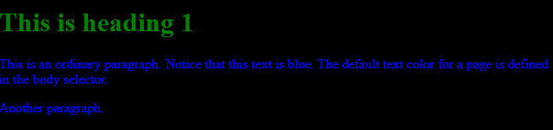
color

Slide 29
Font-Weight
The font-weight property sets how thick or thin characters in text should be displayed.
The font-weight property sets how thick or thin characters in text should be displayed.
font-weight: normal|bold|bolder|lighter|number|initial|inherit;

Slide 30
Font-Weight
<!DOCTYPE html>
<html>
<head>
<style>
p.normal {
font-weight: normal;
}
p.light {
font-weight: lighter;
}
p.thick {
font-weight: bold;
}
p.thicker {
font-weight: 900;
}
The font-weight property sets how thick or thin characters in text should be displayed.

Slide 31
Font-Weight
The font-weight property sets how thick or thin characters in text should be displayed.
</style>
</head>
<body>
<h1>The font-weight Property</h1>
<p class="normal">This is a paragraph.</p>
<p class="light">This is a paragraph.</p>
<p class="thick">This is a paragraph.</p>
<p class="thicker">This is a paragraph.</p>
</body>
</html>

Slide 32
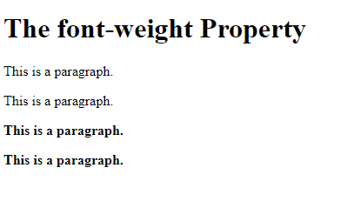
Font-Weight
The font-weight property sets how thick or thin characters in text should be displayed.

Slide 33
text-decoration
The text-decoration shorthand CSS property sets the appearance of decorative lines on text. It is a shorthand for text-decoration-line, text-decoration-color, text-decoration-style, and the newer text-decoration-thickness property.
Value Description
text-decoration-line Sets the kind of text decoration to use (like underline, overline, line-through)
text-decoration-color Sets the color of the text decoration
text-decoration-style Sets the style of the text decoration (like solid, wavy, dotted, dashed, double)
initial Sets this property to its default value. Read about initial
inherit Inherits this property from its parent element. Read about inherit
The font-weight property sets how thick or thin characters in text should be displayed.

Slide 34
text-decoration
<!DOCTYPE html>
<html>
<head>
<style>
body{
background:black;
color:white;
}
h1 {
text-decoration: overline;
}
h2 {
text-decoration: line-through;
}
The font-weight property sets how thick or thin characters in text should be displayed.

Slide 35
text-decoration
The font-weight property sets how thick or thin characters in text should be displayed.
h3 {
text-decoration: underline;
}
h4 {
text-decoration: underline overline;
}
</style>
</head>
<body>

Slide 36
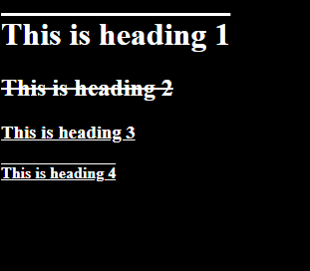
text-decoration
The font-weight property sets how thick or thin characters in text should be displayed.

Slide 37
font-size
The font-weight property sets how thick or thin characters in text should be displayed.
The font-size property sets the size of a font.
font-size:medium|xx-small|x-small|small|large|x-large|xx-large|smaller|larger|length|initial|inherit;

Slide 38
font-size
<!DOCTYPE html>
<html>
<head>
<style>
div.a {
font-size: 15px;
}
div.b {
font-size: large;
}
div.c {
font-size: 150%;
}
</style>
</head>
<body>
<h1>The font-size Property</h1>
The font-weight property sets how thick or thin characters in text should be displayed.

Slide 39
font-size
The font-weight property sets how thick or thin characters in text should be displayed.
<div class="a">This is some text.</div>
<div class="b">This is some text.</div>
<div class="c">This is some text.</div>
</body>
</html>

Slide 40
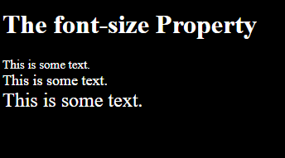
font-size
Output:
The font-weight property sets how thick or thin characters in text should be displayed.

Slide 41
letter-spacing
The letter-spacing property increases or decreases the space between characters in a text.
The font-weight property sets how thick or thin characters in text should be displayed.
<!DOCTYPE html>
<html>
<head>
<style>
h1 {
letter-spacing: 15px;
}
h2 {
letter-spacing: 2px;
}
h3 {
letter-spacing: -1px;
}

Slide 42
letter-spacing
The font-weight property sets how thick or thin characters in text should be displayed.
</head>
<body>
<h1>This is heading 1</h1>
<h2>This is heading 2</h2>
<h3>This is heading 3</h3>
</body>
</html>

Slide 43
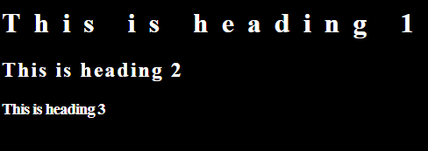
letter-spacing
Output:
The font-weight property sets how thick or thin characters in text should be displayed.

Slide 44
Margin
To shorten the code, it is possible to specify all the margin properties in one property.
The CSS margin properties are used to create space around elements, outside of any of any defined borders.
margin-top
margin-right
margin-bottom
margin-left
So, here is how it works:
The font-weight property sets how thick or thin characters in text should be displayed.
If the margin property has four values:
margin: 25px 50px 75px 100px;
top margin is 25px
right margin is 50px
bottom margin is 75px
left margin is 100px

Slide 45
CSS Selectors
CSS Selectors Types
If we want to apply Styles (CSS) on any HTML element we need to select the particular element first. CSS selectors used to select the HTML elements that we want to style. HTML elements selected by their id, class, and attribute, etc.
There are many types of selectors in CSS that we can use but the important types of selectors in CSS that everyone must learn are these:
Universal Selector
Element Selector
Id Selector
Class Selector
Group Selector
Output:

Slide 46
Id Selector
Output:
CSS Id selector selects the HTML elements by their id. Id attribute used to assign an id to HTML element. The id of every HTML element must unique. So the Id selector used when we want to apply style on the unique HTML element.
The Id name of an HTML element always written with the (#) character.
</html>

Slide 47
Id Selector
Example:
<!DOCTYPE html>
<html>
<head>
<title>id selector</title><style>
#box{
color: white;
background: black;
}
</style>
</head>
<body>
<h1 id="box">id Selector</h1>
</body>
Output:
</html>

Slide 48
Id Selector
Output:
CSS class selector selects the HTML elements by their class. The class attribute of HTML elements used to assign an id to the HTML element.
The class name of HTML element always written with the (.) character.
</html>

Slide 49
Id Selector
Example:
<!DOCTYPE html>
<html>
<head>
<title>class selector</title>
<style>
.box{
color: white;
background: black;
}
</style>
</head>
<body>
<h1 class="box">class Selector</h1>
</body>
</html>
Output:
</html>

Slide 50
Margin
The font-weight property sets how thick or thin characters in text should be displayed.
To shorten the code, it is possible to specify all the margin properties in one property.
If the margin property has three values:
margin: 25px 50px 75px;
top margin is 25px
right and left margins are 50px
bottom margin is 75px
If the margin property has two values:
margin: 25px 50px;
top and bottom margins are 25px
right and left margins are 50px
If the margin property has one value:
margin: 25px; all four margins are 25px

Slide 51
Margin
<!DOCTYPE html>
<html>
<head>
<style>
div {
border: 1px solid black;
margin-top: 100px;
margin-bottom: 100px;
margin-right: 150px;
margin-left: 80px;
background-color: red;
}
</style>
</head>
<body>
<h2>Using individual margin properties</h2>
<div>This div element has a top margin of 100px, a right margin of 150px, a bottom margin of 100px, and a left margin of 80px.</div>
</body>
</html>
The font-weight property sets how thick or thin characters in text should be displayed.

Slide 52
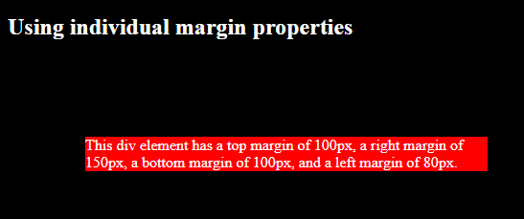
Margin
Output:
The font-weight property sets how thick or thin characters in text should be displayed.

Slide 53
Padding
The CSS padding properties are used to generate space around an element's content, inside of any defined borders.
The font-weight property sets how thick or thin characters in text should be displayed.
CSS has properties for specifying the padding for each side of an element:
padding-top
padding-right
padding-bottom
padding-left
If the padding property has three values:
padding: 25px 50px 75px;
top padding is 25px
right and left paddings are 50px
bottom padding is 75px
If the padding property has four values:
padding: 25px 50px 75px 100px;
top padding is 25px
right padding is 50px
bottom padding is 75px
left padding is 100px

Slide 54
Padding
If the padding property has two values:
padding: 25px 50px;
top and bottom paddings are 25px
right and left paddings are 50px
The font-weight property sets how thick or thin characters in text should be displayed.
If the padding property has one value:
padding: 25px;
all four paddings are 25px

Slide 55
Padding
<!DOCTYPE html>
<html>
<head>
<style>
div {
border: 1px solid black;
background-color: red;
padding-top: 50px;
padding-right: 30px;
padding-bottom: 50px;
padding-left: 80px;
}
</style>
</head>
<body>
<h2>Using individual padding properties</h2>
<div>This div element has a top padding of 50px, a right padding of 30px, a bottom padding of 50px, and a left padding of 80px.</div>
</body>
</html>
The font-weight property sets how thick or thin characters in text should be displayed.

Slide 56
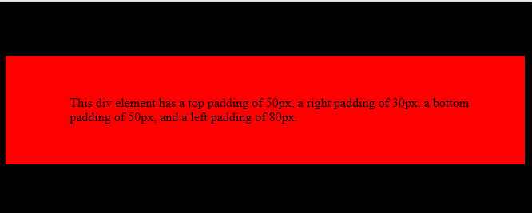
Padding
The font-weight property sets how thick or thin characters in text should be displayed.

Slide 57
Border
The CSS border properties allow you to specify the style, width, and color of an element's border.
The border-style property specifies what kind of border to display.
The following values are allowed:
dotted - Defines a dotted border
dashed - Defines a dashed border
solid - Defines a solid border
double - Defines a double border
groove - Defines a 3D grooved border. The effect depends on the border-color value
ridge - Defines a 3D ridged border. The effect depends on the border-color value
inset - Defines a 3D inset border. The effect depends on the border-color value
outset - Defines a 3D outset border. The effect depends on the border-color value
none - Defines no border
hidden - Defines a hidden border
The border-style property can have from one to four values (for the top border, right border, bottom border, and the left border).
The font-weight property sets how thick or thin characters in text should be displayed.

Slide 58
Example
<!DOCTYPE html>
<html>
<head>
<style>
body{
background:black;
color:white
}
p.dotted {border-style: dotted;}
p.dashed {border-style: dashed;}
p.solid {border-style: solid;}
p.double {border-style: double;}
p.groove {border-style: groove;}
p.ridge {border-style: ridge;}
p.inset {border-style: inset;}
p.outset {border-style: outset;}
p.none {border-style: none;}
p.hidden {border-style: hidden;}
</style>
</head>
<body>
The font-weight property sets how thick or thin characters in text should be displayed.

Slide 59
Example
<h2>The border-style Property</h2>
<p>This property specifies what kind of border to display:</p>
<p class="dotted">A dotted border.</p>
<p class="dashed">A dashed border.</p>
<p class="solid">A solid border.</p>
<p class="double">A double border.</p>
<p class="groove">A groove border.</p>
<p class="ridge">A ridge border.</p>
<p class="inset">An inset border.</p>
<p class="outset">An outset border.</p>
<p class="none">No border.</p>
<p class="hidden">A hidden border.</p>
</body>
</html>
The font-weight property sets how thick or thin characters in text should be displayed.

Slide 60
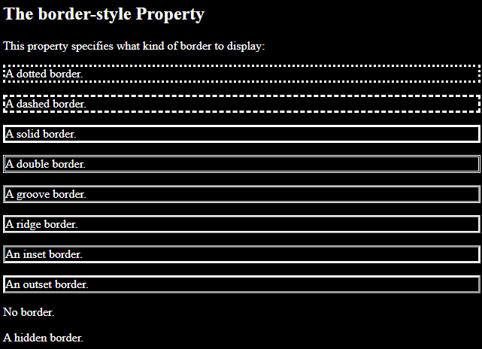
Example
The font-weight property sets how thick or thin characters in text should be displayed.

Slide 61
Border-radius
The border-radius property defines the radius of the element's corners.
Tip: This property allows you to add rounded corners to elements!
This property can have from one to four values. Here are the rules:
Four values - border-radius: 15px 50px 30px 5px; (first value applies to top-left corner, second value applies to top-right corner, third value applies to bottom-right corner, and fourth value applies to bottom-left corner)
Three values - border-radius: 15px 50px 30px; (first value applies to top-left corner, second value applies to top-right and bottom-left corners, and third value applies to bottom-right corner)
Two values - border-radius: 15px 50px; (first value applies to top-left and bottom-right corners, and the second value applies to top-right and bottom-left corners):
One value - border-radius: 15px; (the value applies to all four corners, which are rounded equally:
The font-weight property sets how thick or thin characters in text should be displayed.

Slide 62
Border-radius
<!DOCTYPE html>
<html>
<head>
<style>
#example1 {
border: 2px solid red;
padding: 10px;
border-radius: 25px;
}
#example2 {
border: 2px solid red;
padding: 10px;
border-radius: 50px 20px;
}
</style>
</head>
<body>
The font-weight property sets how thick or thin characters in text should be displayed.

Slide 63
Border-radius
<h2>border-radius: 25px:</h2>
<div id="example1">
<p>The border-radius property defines the radius of the element's corners.</p>
</div>
<h2>border-radius: 50px 20px:</h2>
<div id="example2">
<p>If two values are set; the first one is for the top-left and bottom-right corner, the second one for the top-right and bottom-left corner.</p>
</div>
</body>
</html>
The font-weight property sets how thick or thin characters in text should be displayed.

Slide 64
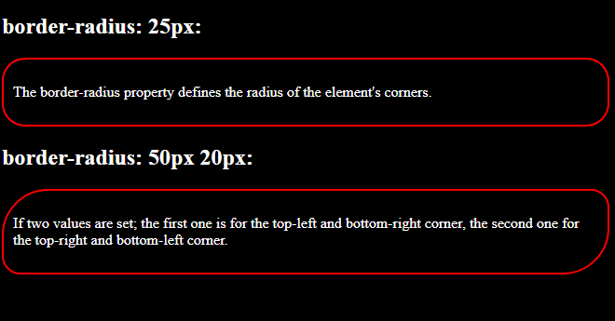
Border-radius
The font-weight property sets how thick or thin characters in text should be displayed.

Slide 65
Background
The CSS background properties are used to add background effects for elements.
The font-weight property sets how thick or thin characters in text should be displayed.
<!DOCTYPE html>
<html>
<head>
<style>
body {
background-color: lightblue;
}
</style>
</head>
<body>
<h1>Hello World!</h1>
<p>This page has a light blue background color!</p>
</body>
</html>

Slide 66
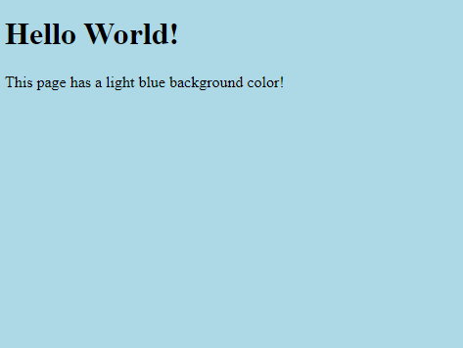
Background
Output:
The font-weight property sets how thick or thin characters in text should be displayed.

Slide 67
Background-image
The background-image property sets one or more background images for an element.
By default, a background-image is placed at the top-left corner of an element, and repeated both vertically and horizontally.
The background of an element is the total size of the element, including padding and border (but not the margin).
The font-weight property sets how thick or thin characters in text should be displayed.

Slide 68
Background-image
<!DOCTYPE html>
<html>
<head>
<style>
body {
background-image: url("img_tree.gif");
background-color: #cccccc;
}
</style>
</head>
<body>
</body>
</html>

Slide 69
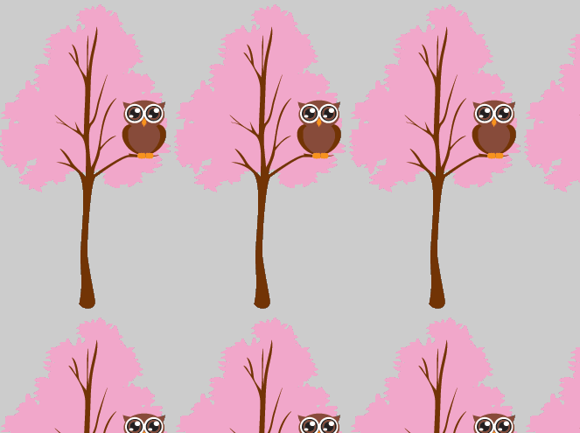
Background-image
Output:

Slide 70
Background-Size
The background-size property specifies the size of the background images.
There are four different syntaxes you can use with this property: the keyword syntax ("auto", "cover" and "contain"), the one-value syntax (sets the width of the image (height becomes "auto"), the two-value syntax (first value: width of the image, second value: height), and the multiple background syntax (separated with comma).
background-size: auto|length|cover|contain|initial|inherit;
auto Default value. The background image is displayed in its original size
cover Resize the background image to cover the entire container, even if it has to stretch the image or cut a little bit off one of the edges
contain Resize the background image to make sure the image is fully visible

Slide 71
Background-Size
<!DOCTYPE html>
<html>
<head>
<style>
#example1 {
border: 2px solid black;
padding: 25px;
background: url(mountain.jpg);
background-repeat: no-repeat;
background-size: auto;
}
#example2 {
border: 2px solid black;
padding: 25px;
background: url(mountain.jpg);
background-repeat: no-repeat;
background-size: 300px 100px;
}

Slide 72
Background-Size
<</style>
</head>
<body>
<h2>background-size: auto (default):</h2>
<div id="example1">
<h2>Hello World</h2>
<p>The background image is displayed in its original size.</p>
</div>
h2>background-size: 300px 100px:</h2>
<div id="example2">
<h2>Hello World</h2>
<p>Here, the background image is set to 300px wide and 100px high.</p>
</div>
</body>
</html>

Slide 73
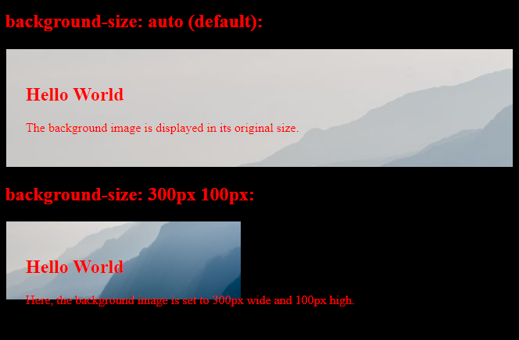
Background-Size
Output:

Slide 74
Display Property
The display property is the most important CSS property for controlling layout.
The display property specifies if/how an element is displayed.
Every HTML element has a default display value depending on what type of element it is. The default display value for most elements is block or inline.

Slide 75
Display-block
Block-level Elements
A block-level element always starts on a new line and takes up the full width available (stretches out to the left and right as far as it can).
Examples of block-level elements:
<div>
<h1> - <h6>
<p>
<form>
<header>
<footer>
<section>

Slide 76
Display-block
Block: This property is used as the default property of div. This property places the div one after another vertically. The height and width of the div can be changed using the block property if the width is not mentioned, then the div under block property will take up the width of the container.

Slide 77
Display-block
<!DOCTYPE html>
<html>
<head>
<title>CSS | Display property</title>
<style>
#geeks1{
height: 100px;
width: 200px;
background: teal;
display: block;
}
#geeks2{
height: 100px;
width: 200px;
background: cyan;
display: block;
}
#geeks3{
height: 100px;
width: 200px;
background: green;
display: block;
}

Slide 78
.gfg {
margin-left:20px;
font-size:42px;
font-weight:bold;
color:#009900;
}
.geeks {
font-size:25px;
margin-left:30px;
}
.main {
margin:50px;
text-align:center;
}
</style>
</head>
<body>
<div class = "gfg">GeeksforGeeks</div>
<div class = "geeks">display: block; property</div>
<div class = "main">
<div id="geeks1">Block 1 </div>
<div id="geeks2">Block 2</div>
<div id="geeks3">Block 3</div>
</div>
</body>
</html>
Display-block

Slide 79
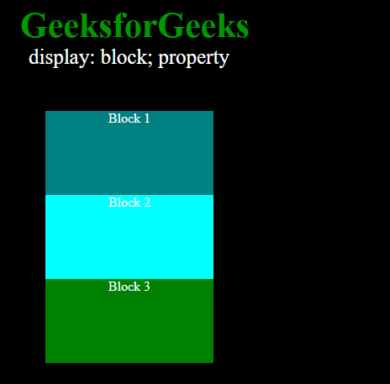
Display-block
Output:

Slide 80
Display-Inline
Inline: This property is the default property of anchor tags. This is used to place the div inline i.e. in a horizontal manner. The inline display property ignores the height and the width set by the user.

Slide 81
Display-Inline
<!DOCTYPE html>
<html>
<head>
<title>CSS | Display property</title>
<style>
body{
background:black;
}
#main{
height: 200px;
width: 200px;
background: teal;
display: inline;
}
#main1{
height: 200px;
width: 200px;
background: cyan;
display: inline;
}

Slide 82
Display-Inline
#main2{
height: 200px;
width: 200px;
background: green;
display: inline;
}
.gfg {
margin-left:20px;
font-size:42px;
font-weight:bold;
color:#009900;
}
.geeks {
font-size:25px;
margin-left:30px;
}
.main {
margin:50px;
}
</style>
</head>
<body>
<div class = "gfg">GeeksforGeeks</div>
<div class = "geeks">display: inline; property</div>

Slide 83
Display-Inline
<div class = "main">
<div id="main"> BLOCK 1 </div>
<div id="main1"> BLOCK 2</div>
<div id="main2">BLOCK 3 </div>
</div>
</body>
</html>

Slide 84
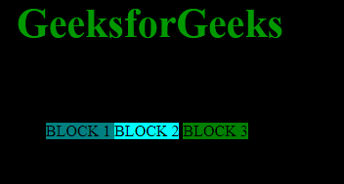
Display-Inline
Output:

Slide 85
Display-Inline-block
Inline-block: This features uses the both properties mentioned above, block and inline. So, this property aligns the div inline but the difference is it can edit the height and the width of block. Basically, this will align the div both in block and inline fashion.

Slide 86
Display-Inline-block
<!DOCTYPE html>
<html>
<head>
<title>CSS | Display property</title>
<style>
#main{
height: 100px;
width: 200px;
background: teal;
display: inline-block;
}
#main1{
height: 100px;
width: 200px;
background: cyan;
display: inline-block;
}
#main2{
height: 100px;
width: 150px;
background: green;
display: inline-block;
}

Slide 87
Display-Inline-block
.gfg {
margin-left:200px;
font-size:42px;
font-weight:bold;
color:#009900;
}
.geeks {
font-size:25px;
margin-left:210px;
}
.main {
margin:50px;
}
</style>
</head>
<body>
<div class = "gfg">GeeksforGeeks</div>
<div class = "geeks">display: Inline-block; property</div>
<div class = "main">
<div id="main"> BLOCK 1 </div>
<div id="main1"> BLOCK 2</div>
<div id="main2">BLOCK 3 </div>
</div>
</body>
</html>

Slide 88
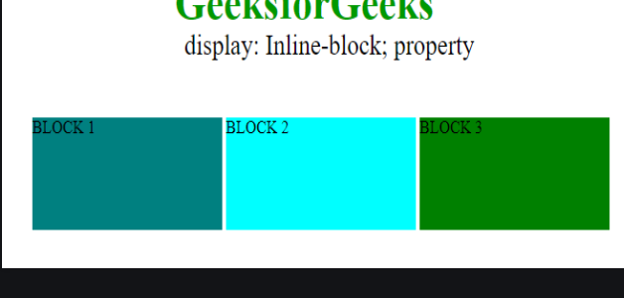
Display-Inline-block

Slide 89
Display-none
None: This property hides the div or the container which use this property. Using it on one of the div it will make working clear.

Slide 90
Display-none
<!DOCTYPE html>
<html>
<head>
<title>CSS | Display property</title>
<style>
#main{
height: 100px;
width: 200px;
background: teal;
display: block;
}
#main1{
height: 100px;
width: 200px;
background: cyan;
display: none;
}
#main2{
height: 100px;
width: 200px;
background: green;
display: block;
}

Slide 91
Display-none
.gfg {
margin-left:20px;
font-size:42px;
font-weight:bold;
color:#009900;
}
.geeks {
font-size:25px;
margin-left:20px;
}
.main {
margin:50px;
}
</style>
</head>
<body>
<div class = "gfg">GeeksforGeeks</div>
<div class = "geeks">display: none; property</div>
<div class = "main">
<div id="main"> BLOCK 1 </div>
<div id="main1"> BLOCK 2</div>
<div id="main2">BLOCK 3 </div>
</div>
</body>
</html>

Slide 92
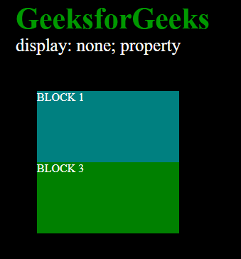
Display-none
Output:

Slide 93
Display-flex
The flex CSS shorthand property is the combination of flex-grow, flex-shrink, and flex-basis property. It is used to set the length of flexible items. The flex property is much responsive and mobile-friendly. It is easy to position child elements and the main container. The margin doesn’t collapse with the content margins. The order of any element can be easily changed without editing the HTML section.
Syntax:
flex: flex-grow flex-shrink flex-basis|auto|initial|inherit;
Property Values:
flex-grow Property: A number that specifies, how much items will grow relative to the rest of the flexible items.

Slide 94
Display-flex
flex-shrink Property: A number that specifies, how much items will shrink relative to the rest of the flexible items.
flex-basis Property: It sets the length of items. Legal values of flex-basis are: auto, inherit, or a number followed by %, em, px, or any other length unit.
flex-wrap Property: The CSS flex-wrap property is used to specify whether flex items are forced into a single line o

Slide 95
Display-flex
wrapped onto multiple lines.
The flex property can be specified with the help of 1, 2 or 3 values:
One-value syntax: the value should contain one of following:
number: If it is represented as flex: <number> 1 0; then the value of flex-shrink, flex-basis will supposed to be 1 & 0 respectively.
It can be specified by one of the keyword as auto, none or initial.
Two-value syntax: It must contains the following values:
The first value should be the number that will represent the flex-grow.

Slide 96
Display-flex
The second value should contain one of the following:
number: If it is number then it will represented as flex-shrink.
a width with the valid value will represents the flex-basis.
Three-value syntax: The values should be in the same order:
first number represents the flex-grow.
second number represents the flex-shrink.
a width with the valid value will represents the flex-basis.

Slide 97
Display-flex
<!DOCTYPE html>
<html>
<head>
<title> CSS flex Property </title>
<style>
#Geeks {
width: 300px;
height: 200px;
border: 1px solid black;
display: flex;
}

Slide 98
Display-flex
#Geeks div {
flex: 1;
}
.GFG1 {
background-color: green;
}
.GFG2 {
background-color: lightgreen;
}
.GFG3 {
background-color: darkgreen;
}

Slide 99
Display-flex
</style>
</head>
<body>
<h2>CSS flex Property</h2>
<div id="Geeks">
<div class="GFG1"> GeeksforGeeks </div>
<div class="GFG2"> Lite Content </div>
<div class="GFG3"> Special Content </div>
</div>
</body>
</html>

Slide 100
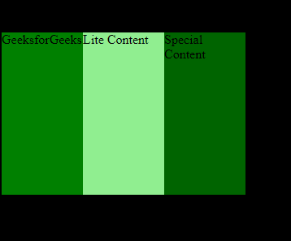
Display-flex
Output:

Slide 101
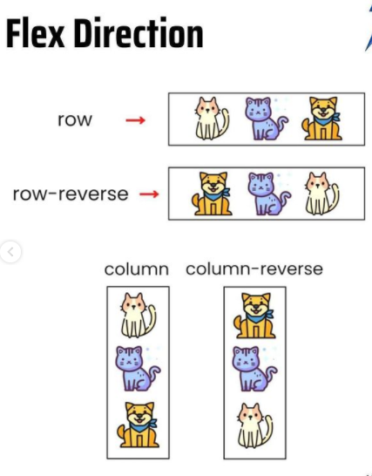
Display-flex

Slide 102
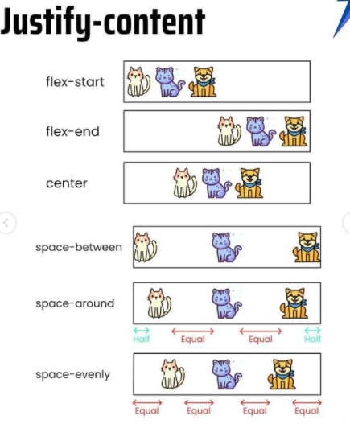
Display-flex

Slide 103
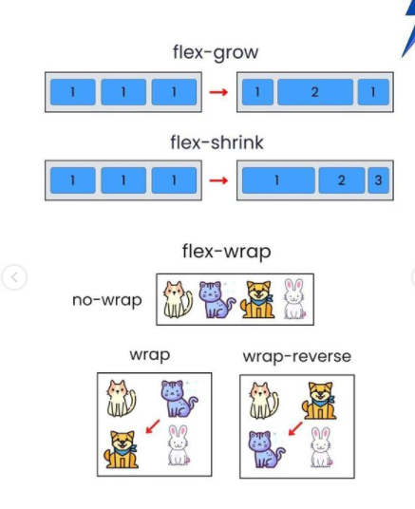
Display-flex

Slide 104
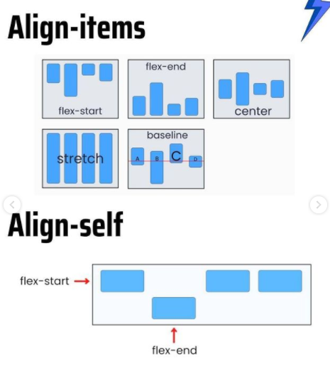
Display-flex

Slide 105
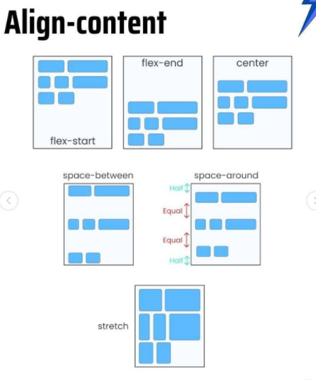
Display-flex

Slide 106
Display-Grid
The CSS grid layout module is used to create a grid-based layout system, with the help of rows and columns it makes it easier to design any webpage without using floats and positioning.
syntax:
.class {
display:grid;
}
Note: An HTML element becomes a grid if that element sets display: grid; in style section or inline-grid. Below you will see both examples.
CSS Grid Layout Properties: These are the following grid-layout properties:
column-gap: It is used to specify the amount of gap between the columns in which a given text is divided using the column-count property.
gap: It is used to set the spacing also caller gutter between the rows and columns.
grid: It offers a grid-based layout system, with rows and columns, making it easier to design web pages without floats and positioning.
grid-area: It is used to set a grid item size and location in a grid layout.

Slide 107
Display-Grid
grid-auto-columns: It is used to specify the size for the columns of implicitly generated grid containers.
grid-auto-flow: It specifies exactly how auto-placed items get flow into the grid.
grid-auto-rows: It is used to specify the size for the rows of implicitly generated grid containers.
grid-column: It describes the number of properties that allow to design of grid structures and control the placement of grid items using CSS.
grid-column-end: It explains the number of columns an item will span, or on which column-line the item will end.
grid-column-gap: It is used to set the size of the gap between the columns in a grid layout.
grid-column-start: It defines for which column line item will start.
grid-gap: It is used to sets the size of the gap between the rows and columns in a grid layout.

Slide 108
Display-Grid
grid-row: It is used to specify the size and location in a grid layout.
grid-row-end: It is used to define the grid item’s end position within a grid row by specifying the inline edge of its grid area.
grid-row-gap: It is used to define the size of the gap between the grid elements.
grid-row-start: It is used to define the grid items’ start position within the grid row by specifying the inline start edge of its grid area.
grid-template: It is a shorthand property for defining grid columns, rows, and areas.
grid-template-areas: It is used to specify the area within the grid layout.
grid-template-columns: It is used to set the number of columns and size of the columns of the grid.
grid-template-rows: It is used to set the number of rows and height of the rows in a grid.

Slide 109
Display-Grid
<!DOCTYPE html>
<html>
<head>
<style>
/* Designing all grid */
.grid-container {
display: grid;
grid-template-columns: auto auto auto;
background-color: gray;
padding: 5px;
}

Slide 110
Display-Grid
/* Designing all grid-items */
.grid-item {
background-color: rgba(255, 255, 255, 0.8);
border: 1px solid black;
padding: 20px;
font-size: 30px;
text-align: center;
}

Slide 111
Display-Grid
/* Designing h1 element */
h1 {
color: green;
text-align: center;
</style>
</head>

Slide 112
Display-Grid
<body>
<h1>GeeksforGeeks</h1>
<!-- Creating grid -->
<div class="grid-container">
<div class="grid-item">1</div>
<div class="grid-item">2</div>
<div class="grid-item">3</div>
<div class="grid-item">4</div>
<div class="grid-item">5</div>
<div class="grid-item">6</div>
<div class="grid-item">7</div>
<div
class="grid-item">8</div>
<div class="grid-item">9</div>
</div>
</body>
</html>

Slide 113
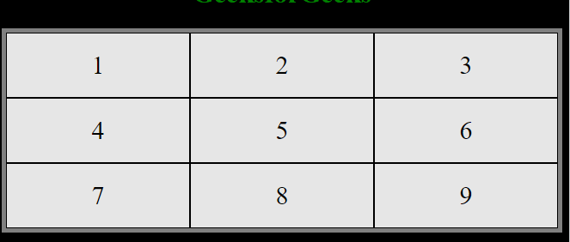
Display-Grid
Output:

Slide 114
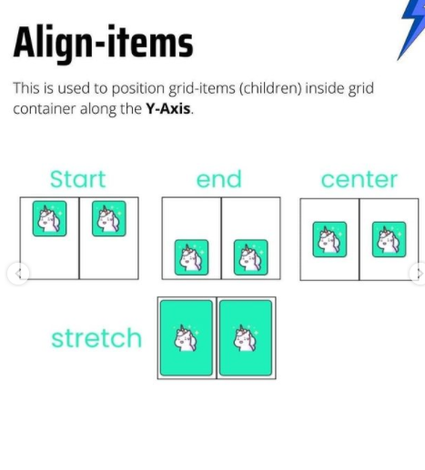
Display-Grid

Slide 115
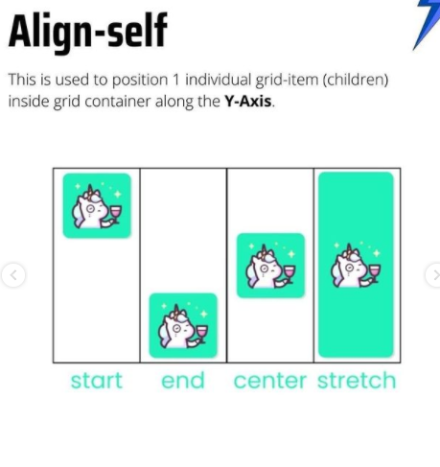
Display-Grid

Slide 116
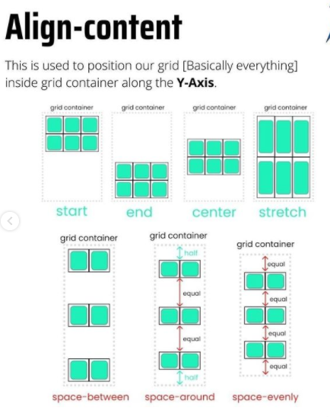
Display-Grid

Slide 117
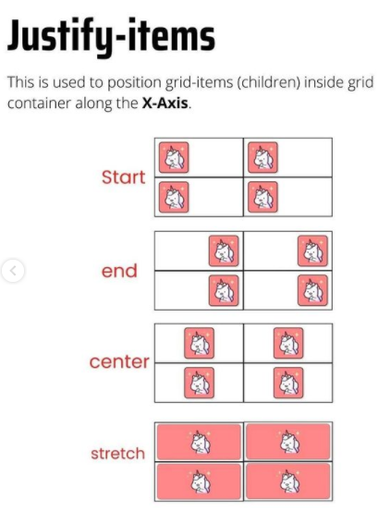
Display-Grid

Slide 118
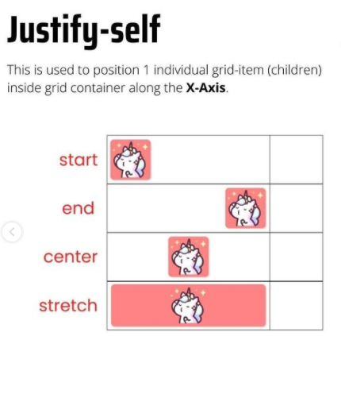
Display-Grid

Slide 119
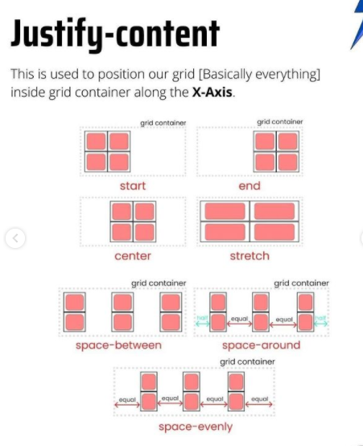
Display-Grid

Slide 120
Position
The position property in CSS tells about the method of positioning for an element or an HTML entity. There are five different types of position property available in CSS:
Fixed
Static
Relative
Absolute
Sticky
The positioning of an element can be done using the top, right, bottom, and left properties. These specify the distance of an HTML element from the edge of the viewport. To set the position by these four properties, we have to declare the positioning method. Let’s understand each of these position methods in detail:

Slide 121
Position Sticky
position: static;
HTML elements are positioned static by default.
Static positioned elements are not affected by the top, bottom, left, and right properties.
An element with position: static; is not positioned in any special way; it is always positioned according to the normal flow of the page:

Slide 122
Position relative
position: relative;
An element with position: relative; is positioned relative to its normal position.
Setting the top, right, bottom, and left properties of a relatively-positioned element will cause it to be adjusted away from its normal position. Other content will not be adjusted to fit into any gap left by the element.

Slide 123
Position fixed
position: fixed;
An element with position: fixed; is positioned relative to the viewport, which means it always stays in the same place even if the page is scrolled. The top, right, bottom, and left properties are used to position the element.
A fixed element does not leave a gap in the page where it would normally have been located.

Slide 124
Position absolute
position: absolute;
An element with position: absolute; is positioned relative to the nearest positioned ancestor (instead of positioned relative to the viewport, like fixed).
However; if an absolute positioned element has no positioned ancestors, it uses the document body, and moves along with page scrolling.
Note: Absolute positioned elements are removed from the normal flow, and can overlap elements.

Slide 125
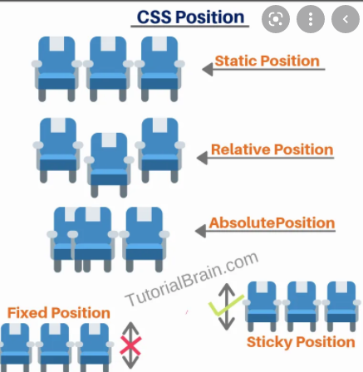
Position

Slide 126
Visibility
The visibility property specifies whether or not an element is visible.
Hidden elements take up space on the page. Use the display property to both hide and remove an element from the document layout!

Slide 127
Visibility
visibility: visible|hidden|collapse|initial|inherit;
<!DOCTYPE html>
<html>
<head>
<style>
body{
background:black;
color:white
}
h2.a {
visibility: visible;
}
h2.b {
visibility: hidden;
}

Slide 128
Visibility
</style>
</head>
<body>
<h1>The visibility Property</h1>
<h2 class="a">This heading is visible</h2>
<h2 class="b">This heading is hidden</h2>
<p>Notice that the hidden heading still takes up space on the page.</p>
</body>
</html>

Slide 129
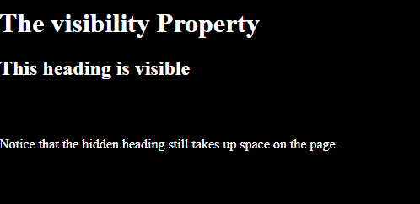
Visibility
Output:

Slide 130
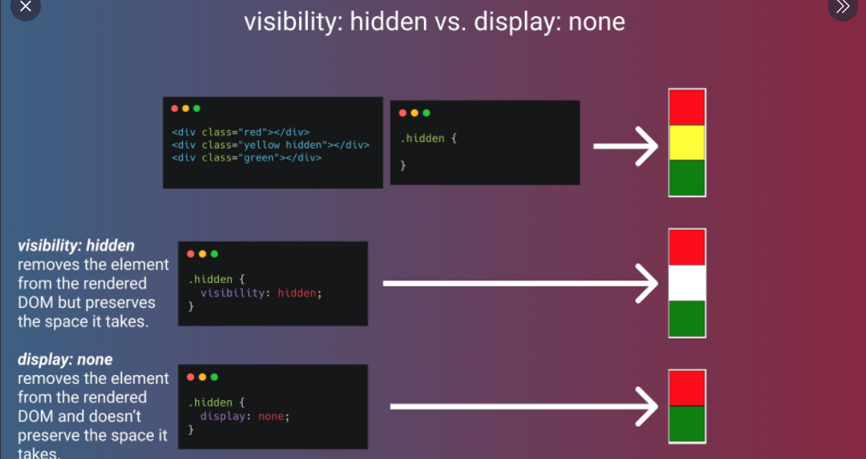
display:none vs hidden

Slide 131
Float
The float CSS property is used to position the elements to the left, right, of its container along with permitting the text and inline elements to wrap around it. The float property defines the flow of content in the page. The remaining elements will be part of the flow if the element is removed from the normal flow of the content. This property is ignored by the absolutely positioned elements. It can be written in a CSS file or can be directly specified in the style of an element.

Slide 132
Float
float: none|left|right|initial|inherit;
Property values:
none: This is the default value & the element does not float.
left: Element floats on the left side of the container.
right: Element floats on the right side of the container.
initial Element will be set to its default value.
inherit: Element inherits floating property of its parent property.

Slide 133
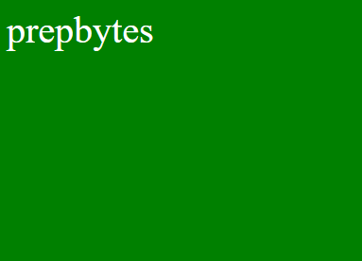
Float left
Output:
<!DOCTYPE html>
<html>
<head>
<title>Float</title>
</head>
<style>
body{
background:black;
}
</style>
<body>
<div class="GFG" style="font-size:40px;
color:white; float:left;"> prepbytes </div>
</body>
</html>

Slide 134
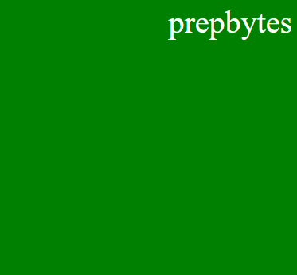
Float right
Output:
<!DOCTYPE html>
<html>
<head>
<title>Float</title>
</head>
<style>
body{
background:black;
}
</style>
<body>
<div class="GFG" style="font-size:40px;
color:white; float:right;"> prepbytes </div>
</body>
</html>

Slide 135
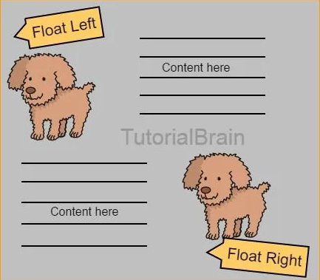
Float

Slide 136
clear
The clear property is used to specify that which side of floating elements are not allowed to float. It sets or returns the position of the element in relation to floating objects. If the element can fit horizontally in the space next to another element which is floated, it will.
Syntax:
clear: none|left|right|both|initial;
Property values:
none: It has a default value. It allows element are float on both the sides.

Slide 137
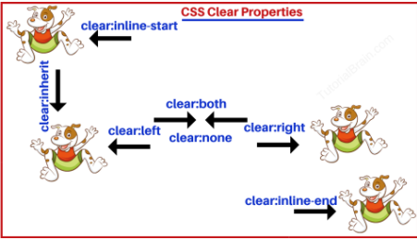
clear

Slide 138
Z-index
The z-index property is used to displace elements on the z-axis i.e in or out of the screen. It is used to define the order of elements if they overlap on each other.
Syntax:
z-index: auto|number|initial|inherit;
Property values:
auto: The stack order is equal to that of the parent(default).
number: The stack order depends in the number.
initial: Sets the property to its default value.
inherit: Inherits the property from the parent element.

Slide 139
Z-index
<!DOCTYPE html>
<html>
<head>
<style>
.container {
position: relative;
}
.black-box {
position: relative;
z-index: 1;
border: 2px solid black;
height: 100px;
margin: 30px;
}
.gray-box {
position: absolute;
z-index: 3; /* gray box will be above both green and black box */
background: lightgray;
height: 60px;
width: 70%;
left: 50px;
top: 50px;
}

Slide 140
Z-index
.green-box {
position: absolute;
z-index: 2; /* green box will be above black box */
background: lightgreen;
width: 35%;
left: 270px;
top: -15px;
height: 100px;
}
</style>
</head>
<body>
<h1>Z-index Example</h1>
<p>An element with greater stack order is always above an element with a lower stack order.</p>
<div class="container">
<div class="black-box">Black box (z-index: 1)</div>
<div class="gray-box">Gray box (z-index: 3)</div>
<div class="green-box">Green box (z-index: 2)</div>
</div>
</body>
</html>

Slide 141
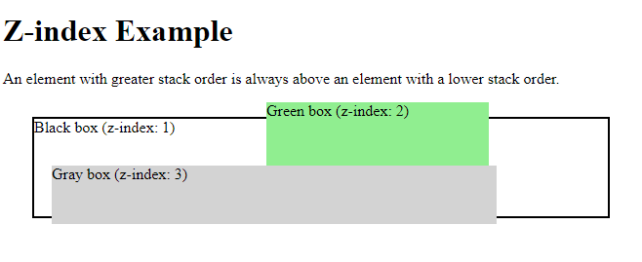
Z-index
Output:

Slide 142
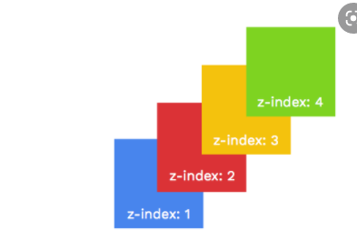
Z-index

Slide 143
Box-Shadow
The box-shadow property in CSS is used to give a shadow-like effect to the frames of an element. The multiple effects can be applied to the element’s frame which is separated by the comma. The box-shadow can be described using X and Y offsets relative to the element, blur and spread radius, and color.
Syntax:
box-shadow: h-offset v-offset blur spread color |none|inset|initial|
inherit;
Default Value : Its default value is none.
Property Value: All the properties are described well with the example below.
h-offset: It is required to set the position of the shadow horizontally. The positive value is used to set the shadow on the right side of the box and a negative value is used to set the shadow on the left side of the box.
v-offset: It is required to set the position of shadow value vertically. The positive value is used to set the shadow below to the box and a negative value is used to set the shadow above the box.
blur: It is an optional attribute, the work of this attribute is to blur the shadow of the box.
box-shadow: h-offset v-offset blur;

Slide 144
Box-Shadow
<!DOCTYPE html>
<html>
<head>
<style>
body{
background:black;
color:white
}
#example1 {
border: 1px solid;
padding: 10px;
box-shadow: 5px 10px;
}
#example2 {
border: 1px solid;
padding: 10px;
box-shadow: 5px 10px #888888;
}
</style>

Slide 145
Box-Shadow
</head>
<body>
<h1>The box-shadow Property</h1>
<p>The box-shadow property defines the shadow of an element:</p>
<h2>box-shadow: 5px 10px:</h2>
<div id="example1">
<p>A div element with a shadow. The first value is the horizontal offset and the second value is the vertical offset. The shadow color will be inherited from the text color.</p>
</div>
<h2>box-shadow: 5px 10px #888888:</h2>
<div id="example2">
<p>You can also define the color of the shadow. Here the shadow color is grey.</p>
</div>
</body>
</html>

Slide 146
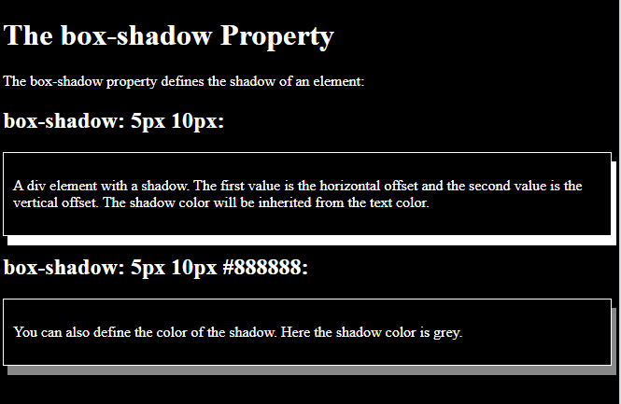
Box-Shadow

Slide 147
Text-Shadow
The text-shadow property in CSS is used to add shadows to the text. This property accepts a list of shadows that are to be applied to the text, separated by the comma. The default value of the text-shadow property is none.
Syntax:
text-shadow: h-shadow v-shadow blur-radius color|none|initial|
inherit;
Property values:

Slide 148
Text-Shadow
h-shadow: This property is required & used to specify the position of horizontal shadow. It accepts the negative values.
v-shadow: This property is required & used to specify the position of vertical shadow. It also accepts the negative values.
blur-radius: It is used to set the blur radius. Its default value is 0 & is optional.
none: It represents no shadow added to the text, this is the default value.
color: It is used to set the color of the shadow. It is optional.
initial: It is used to set text-shadow to its default value.
inherit: This property is inherited from its parent element.

Slide 149
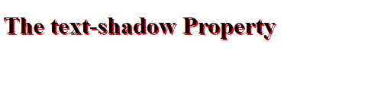
Text-Shadow
<!DOCTYPE html>
<html>
<head>
<style>
h1 {
text-shadow: 2px 2px #FF0000;
}
</style>
</head>
<body>
<h1>The text-shadow Property</h1>
</body>
</html>

Slide 150
Css Gradients
CSS gradients let you display smooth transitions between two or more specified colors.
CSS defines three types of gradients:
Linear Gradients (goes down/up/left/right/diagonally)
Radial Gradients (defined by their center)
Conic Gradients (rotated around a center point)

Slide 151
Linear Gradients
To create a linear gradient you must define at least two color stops. Color stops are the colors you want to render smooth transitions among. You can also set a starting point and a direction (or an angle) along with the gradient effect.
Syntax:
background-image: linear-gradient(direction, color-stop1, color-stop2, ...);
background-image: linear-gradient(direction, color-stop1, color-stop2, .
..);

Slide 152
Linear Gradients
<!DOCTYPE html>
<html>
<head>
<style>
body{
background:black;
color:white
}
#grad1 {
height: 200px;
background-color: red; /* For browsers that do not support gradients */
background-image: linear-gradient(red, yellow);
}
</style>
</head>
<body>
<h1>Linear Gradient - Top to Bottom</h1>
<p>This linear gradient starts red at the top, transitioning to yellow at the bottom:</p>
<div id="grad1"></div>
</body>
</html>

Slide 153
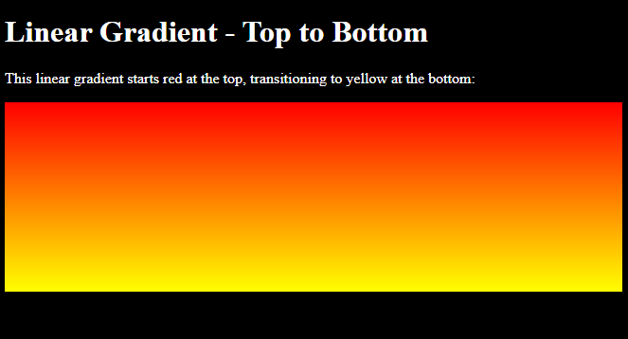
Linear Gradients

Slide 154
Radial Gradients
The radial-gradient() function sets a radial gradient as the background image.
A radial gradient is defined by its center.
To create a radial gradient you must define at least two color stops.
background-image: radial-gradient(shape size at position, start-color, ..., last-color);

Slide 155
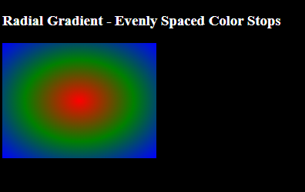
Radial Gradients
<!DOCTYPE html>
<html>
<head>
<style>
#grad1 {
height: 150px;
width: 200px;
background-image: radial-gradient(red, green, blue);
}
</style>
</head>
<body>
<h3>Radial Gradient - Evenly Spaced Color Stops</h3>
<div id="grad1"></div>
</body>
</html>

Slide 156
Css transform
The transform property in CSS is used to change the coordinate space of the visual formatting model. This is used to add effects like skew, rotate, translate, etc on elements.
Syntax:
transform: none|transform-functions|initial|inherit;
Note: The transformations can be of 2-D or 3-D type.
Values:
none: No transformation takes place.
matrix(x, x, x, x, x, x): It specifies a matrix transformation of 2-D type. It takes 6 values.
matrix3d(x, x, x, x, x, x, x, x, x): It specifies a matrix transformation of 3-D type. It takes 9 values.
translate(x, y): It specifies a translation across the X and Y axes.
translate3d(x, y, z): It specifies a translation across the X, Y, and Z axes.

Slide 157
Css transform
translateX(x): It specifies the translation across the X-axis only.
translateY(y): It specifies the translation across the Y-axis only.
translateZ(z): It specifies the translation across the Z-axis only.
rotate(angle): It specifies the angle of rotation.
rotateX(angle): It specifies the rotation along with the X-axis corresponding to the angle of rotation.
roatateY(angle): It specifies the rotation along with the Y-axis corresponding to the angle of rotation.
roteteZ(angle): It specifies the rotation along with the Z-axis corresponding to the angle of rotation.
scale(x, y): It specifies the scale transformation along the X and Y axes.
scale3d(x, y, z): It specifies the scale transformation along the X, Y, and Z axes.
scaleX(x): It specifies the scale transformation along the X-axis.
scaleY(y): It specifies the scale transformation along the Y-axis.

Slide 158
Css transform
scaleZ(z): It specifies the scale transformation along the Z-axis.
scale3d(x, y, z): It specifies the scale transformation along the X, Y, and Z axes.
skew(angle, angle): It specifies the skew transformation along the X and Y axes corresponding to the skew angles.
skewX(angle): It specifies the skew transformation along with the X-axis corresponding to the skew angle.
skewY(angle): It specifies the skew transformation along with the Y-axis corresponding to the skew angle.
skewZ(angle): It specifies the skew transformation along with the Z-axis corresponding to the skew angle.
perspective(x): It specifies the perspective of an element. Refer: Perspective property
initial: It initializes the element to its default value.
inherit: It inherits the value from its parent element.

Slide 159
Css transform
div.b {
width: 150px;
height: 80px;
background-color: yellow;
-ms-transform: skewY(20deg); /* IE 9 */
transform: skewY(20deg);
}
div.c {
width: 150px;
height: 80px;
background-color: yellow;
-ms-transform: scaleY(1.5); /* IE 9 */
transform: scaleY(1.5);
}
<!DOCTYPE html>
<html>
<head>
<style>
body{
background:black;
color:blue;
}
div.a {
width: 150px;
height: 80px;
background-color: yellow;
-ms-transform: rotate(20deg); /* IE 9 */
transform: rotate(20deg);
}
</style>
</head>
<body>
<h1>The transform Property</h1>
<h2>transform: rotate(20deg):</h2>
<div class="a">Hello World!</div>
<br>
<h2>transform: skewY(20deg):</h2>
<div class="b">Hello World!</div>
<br>
<h2>transform: scaleY(1.5):</h2>
<div class="c">Hello World!</div>
</body>
</html>

Slide 160
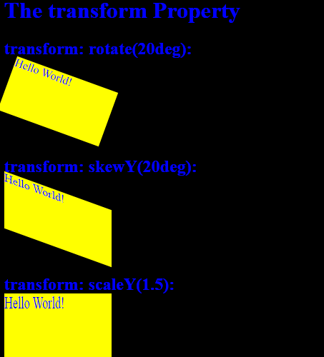
Css transform

Slide 161
Css Animation
CSS Animation: CSS Animations is a technique to change the appearance and behavior of various elements in web pages. It is used to control the elements by changing their motions or display. It has two parts, one which contains the CSS properties which describe the animation of the elements and the other contains certain keyframes which indicate the animation properties of the element and the specific time intervals at which those have to occur.
The @keyframes rule: Keyframes are the foundations with the help of which CSS Animations works. They define the display of the animation at the respective stages of its whole duration.

Slide 162
Css Animation
<!DOCTYPE html>
<html>
<head>
<style>
div {
width: 100px;
height: 100px;
background-color: red;
animation-name: example;
animation-duration: 4s;
}
@keyframes example {
from {background-color: red;}
to {background-color: yellow;}
}
</style>
</head>
<body>
<h1>CSS Animation</h1>
<div></div>
<p><b>Note:</b> When an animation is finished, it goes back to its original style.</p>
</body>
</html>

Slide 163
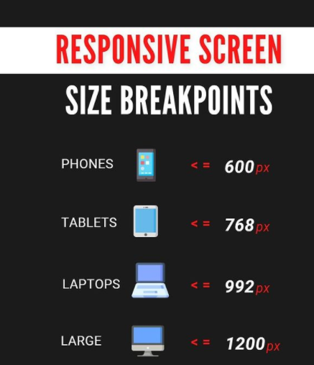
Css Responsive screen

Slide 164
Types of CSS
Inline CSS
Internal CSS
External CSS

Slide 165
Class and Id - CSS Selectors

Slide 166
class vs id
id is unique, an id can appear only once on the page
An element can have only one id.
Classes need not be unique
One class can be used by multiple elements and
You can have id and class both for a element

Slide 167
Fonts

Slide 168
Fonts
font-family
font-style
color
font-weight
text-decoration
font-size
letter-spacing

Slide 169
Font Family
Generic font family – Serif, Sans-Serif, Monospace
Family name– Times New Roman, Arial, Verdana

Slide 170
Font weight
font-weight
normal
bold
bolder
lighter
100 - 900

Slide 171
Font style
normal
italic
oblique
initial
inherit

Slide 172
Text Decoration
text-decoration
text-decoration-line – underline, overline, line-through
text-decoration-color
text-decoration-style – solid, wavy, dotted, dashed, double

Slide 173


Slide 174
Font size
px vs em vs rem vs percentage vs cm

Slide 175
Margin and Padding

Slide 176
Margins
Properties
margin :
margin-top:
margin-bottom:
margin-left:
margin-right:
margin: top right bottom left
margin: 100px 20px 50px 75px;
margin: 100px 20px;
margin : 25px

Slide 177
Padding
padding :
padding-top:
padding-bottom:
padding-left:
padding-right:
padding: top right bottom left

Slide 178
Borders

Slide 179
Border
Border Style Values
Properties
border-width:
border-style:
border-color:
border: border-width border-style border-color
solid
dotted
dashed
groove
ridge
inset
outset
none
hidden
double

Slide 180
Border Radius
Properties
border-radius

Slide 181
Background

Slide 182
Background
background-color
background-image
background-size
background-repeat
background-position

Slide 183
Display & Visibility

Slide 184
Display
block
inline
inline-block
none
flex
grid

Slide 185
display
block
inline
inline-block
none
Common inline elements
Common block elements
a, span, img
div, h1, p

Slide 186


Slide 187


Slide 188
Position

Slide 189
position
static
relative
absolute
fixed
sticky

Slide 190
Visibility
Hidden
visible
collapse
initial
inherit

Slide 191
Float vs clear
Float : When you want any html element to go or to float on a particular side like left or right, then we can use float property.
Clear : If you want that the next element(element2) of element(element1) which is floating either on left on right should come on next line instead of falling in same line then use clear property and give same position as given in float property of the previous element.

Slide 192
Box sizing
box-sizing : border-box
box-sizing : content-box
Default total width = actual width + borders + padding
Default total height = actual height + borders + padding

Slide 193
z-index
z-index property is given specifically to those elements about which we want to decide that it should come on top or bottom
bottom = negative value
top = positive value

Slide 194
Button Styling
There are three ways of creating a button:
<button>Click Here</button>
<a href=“#”>Click Here</a>
<input type=“button” value=“Click Here”>

Slide 195


Slide 196


Slide 197
Text Shadow
text-shadow
none
h-shadow
v-shadow
blur-radius
Color

Slide 198


Slide 199
linear-gradient :
Background-image : linear-gradient(direction, color…)
Direction = to right, to left , to top, to bottom, to bottom right (diagonally), any angle

Slide 200
radial-gradient :
Background-image : radial-gradient(shape at position, direction at x%, color…)
Shape = circle, ellipse
Direction = farthest-corner, closest-side, closest-corner, farthest-side
Position = left right top bottom

Slide 201
Display Grid

Slide 202


Slide 203
display:grid
//columns
grid-template-columns: 20% 50% 30%;
grid-template-columns: 1fr 1fr 1fr;
grid-template-columns: repeat(3, 1fr);
grid-template-columns: repeat(3, 1fr 2fr);
//gap between cells
grid-row-gap:10px ;
grid-column-gap:10px ;
grid-gap: 20px;
//row height
grid-auto-rows: minmax(100px, auto); // flexible row height
grid-auto-rows: 100px; // fixed height of rows
// items alignment
justify-items //parent
align-items: center, start, end, stretch //parent
align-self //child element
justify-self //child element

Slide 204


Slide 205
Gradients

Slide 206
linear-gradient
radial-gradient

Slide 207
Transitions

Slide 208

cubic-bezier

Slide 209
Transformations

Slide 210

Scale : value=1,2…
Skew : value=30deg
Rotate : value=30deg, 1 turn
Translate : value=45px

Slide 211


Slide 212
Animation Properties
name, duration, timing-function, delay, iteration-count, direction, fill-mode;
name : animation name for any css selector
duration : how much time your 1 round of animation effect should take
timing function : lets you vary the speed and propagation of the animation
delay : after how much time animation effect should start
iteration-count : how many times the animation effect should run
fill-mode : backwards/ forwards , when you want your element to stay in the same position what it was in after animation means it should not regain its initial position(before animation started) once the animation is completed

Slide 213
Animation direction property
Animation direction property takes in three major values like reverse, alternate, alternate-reverse, their description is given below :
reverse = when you want your element to rotate anticlockwise
alternate = initially your element will go clockwise then anti-clockwise
alternate-reverse = initially your element will go anti-clockwise then clockwise

Slide 214
Pseudo Selectors
A pseudo - class is a basically a keyword added to a selector that specifies a special state of the selected element.
Ex : button:hover{
color : white
}
Here button is a selector and :hover is the pseudo class.

Slide 215
Pseudo Selectors
List of few pseudo classes which gets used the most:
:hover = when you take your cursor on an element.
:link = matches with the link that have not been visited
:visited = matches links that have been visited
:active = when any link is active, means we are clicking on the link.

Slide 216
:nth-child(n) of CSS
This is one of the pseudo class in CSS. It allows you to select a element of a given type (tag name while writing this css property) based on the expression (written in brackets) among a group of elements.
This expression can be numeric (like 2), a keyword (like odd, even) and formula(like 2n+1)
Example => p:nth-child(odd){
color : white;
}

Slide 217
Combining CSS :
A CSS selector can contain more than one simple selector. Between these selectors we can include a symbol which is known as combinator in CSS.
There are 4 combinators in CSS:
space : descendant selector
> : child selector
+ : adjacent sibling selector
~ : general sibling selector (tilda/ tilde = ~, ` = backtick)

Slide 218
Responsive Design

Slide 219


